Slide 2
Overview
1 Global Company
2 Tyre Brands
2 R&D Centres
7 Manufacturing Facilities
100 Countries Worldwide
19,000 Employees
$3.1bn Revenue

Slide 3
Our Vision
Vision
Driving Progress, Together
Revenue Goal
$5Bn
(FY26)
Purpose
Enabling Excellence
Values
Following our Passion
One Family
Taking Responsibility

Slide 4
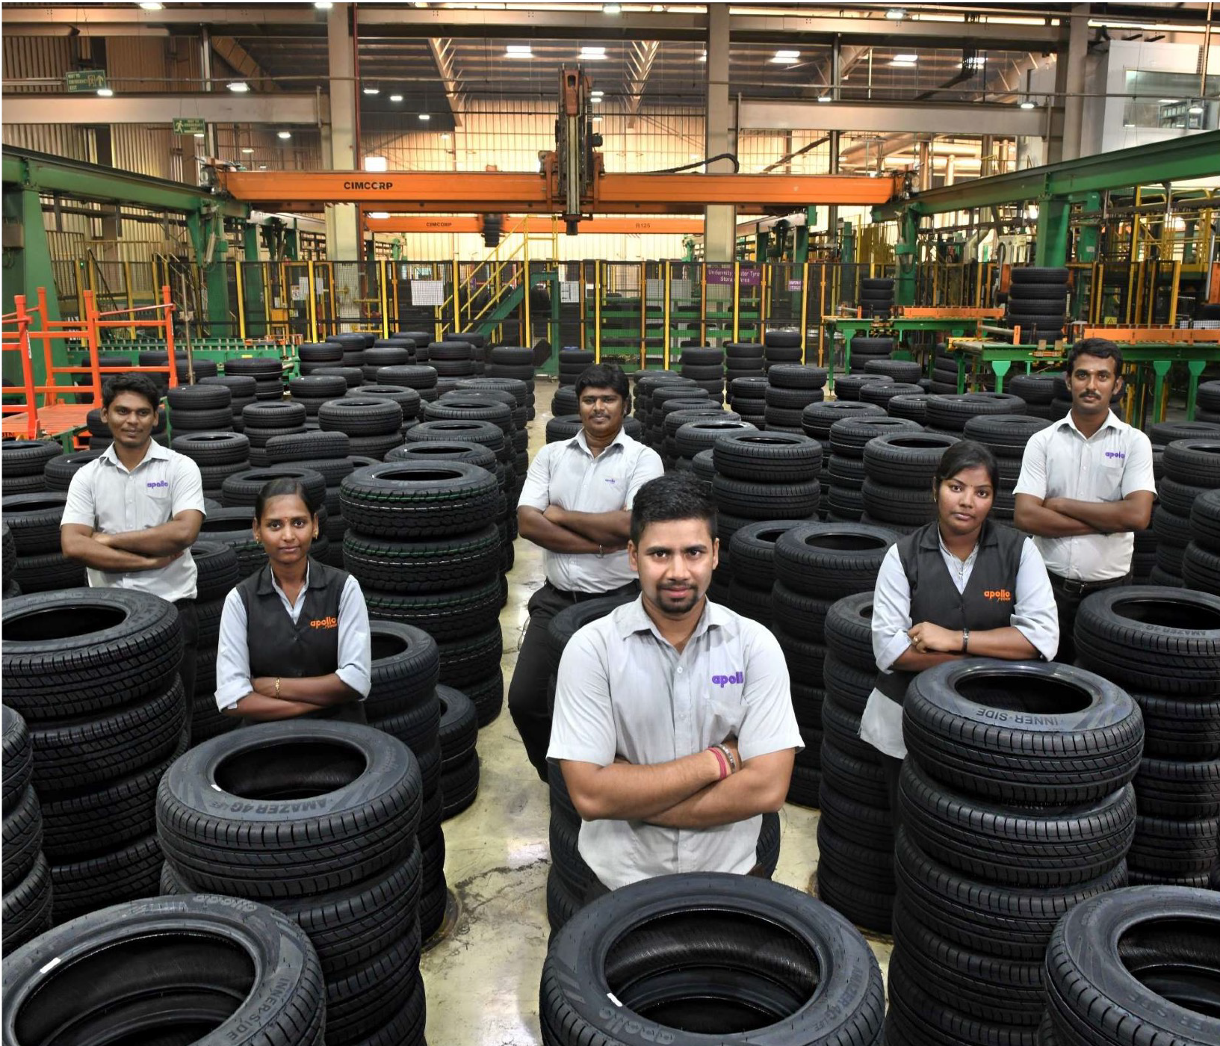
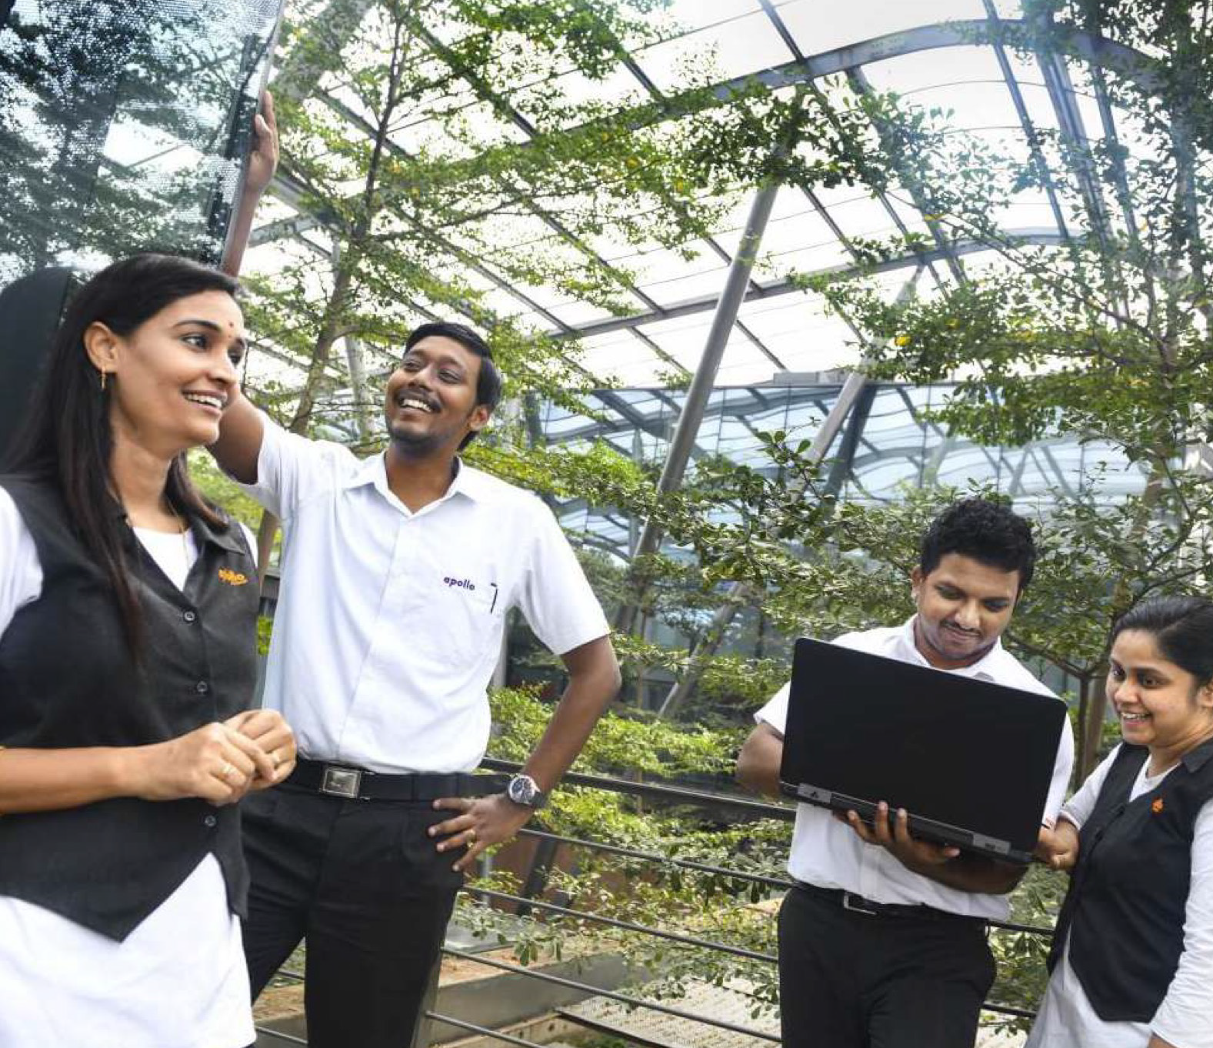
Our Values
Following our Passion
One Family
Taking Responsibility
We champion ideas that inspire us to think big, be brave and challenge the ordinary.
We create an inclusive culture that brings our people, partners and communities together.
We are committed to building a responsible and sustainable business that benefits society.

Slide 5
Our Goals

Slide 6
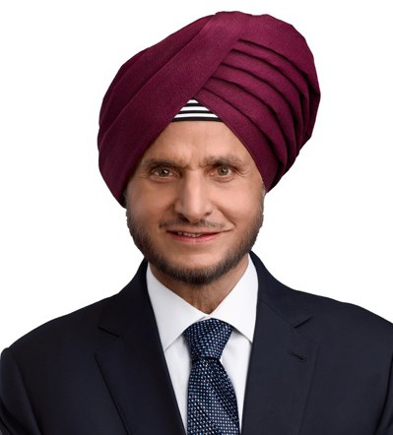
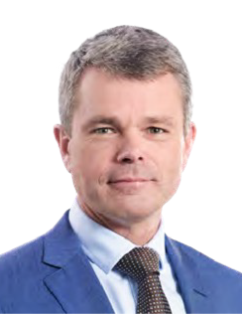
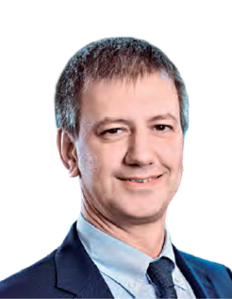
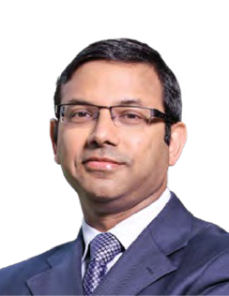
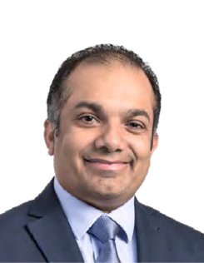
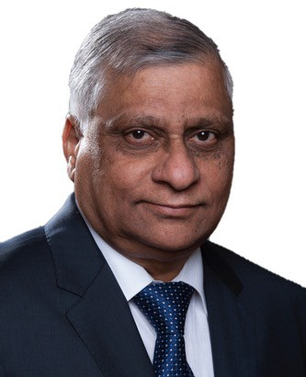
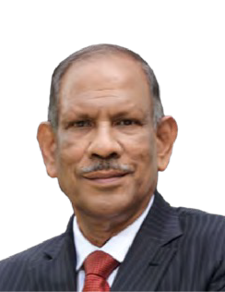
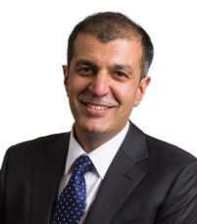
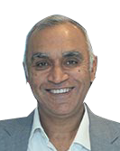
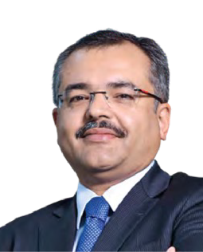
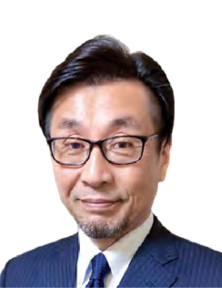
Our Management Team
Highly experienced team with an average tenure of over 20 years in the tyre industry.
Benoit Rivallant
European Operations
Daniele Lorenzetti
Research & Technology
Gaurav Kumar
Finance & Legal
Onkar Kanwar
Chairman
Hizmy Hassen
Digitalisation & Supply Chain
K Prabhakar
Projects
P K Mohamed
(Advisor) Technology
Neeraj Kanwar
Vice Chairman & Managing Director
Satish Sharma
Asia Pacific, Middle East & Africa Operations
Sunam Sarkar
Sustainability, Procurement, Human Resources and Corporate Communications
Yoichi Sato
Quality, Health, Safety & Environment

Slide 7
Our Journey So Far….
Our growth has been driven by a well thought out strategy of organic and inorganic initiatives.

Slide 8
Key Performance Indicators
FY23 (Indian Rupees)
Net Profit
EBITDA
(excluding other income)
33.1 Bn
Revenue from Operation
245.7 Bn
11.1 Bn
Capital Expenditure Outflow
7.8 Bn
EBIT
RoE
9.0 %
19.4 Bn

Slide 9
Key Performance Indicators
Revenue Segmentation (Indian Rupees)
22.6
3.8
6.0
5.0
36.6
9.6
Geography (%)
Customers (%)
Products (%)
28.4
77.4
67.7
Passenger Vehicles Truck-Bus
Off Highway
Light Truck
Other
APMEA
Europe Others
Replacement OEM
43
Revenue from Operations (₹ Bn)
Net Profit (₹ Bn)
Capital Expenditure Outflow (₹ Bn)
175.49
6.80
FY19
22.93
FY19
FY19
FY19
163.50
4.76
28.36
FY20
FY20
FY20
FY20
173.97
3.50
11.90
FY21
FY21
FY21
209.48
6.39
18.46
FY22
FY22
FY22
245.68
11.05
7.75
FY23
FY23
FY23

Slide 10
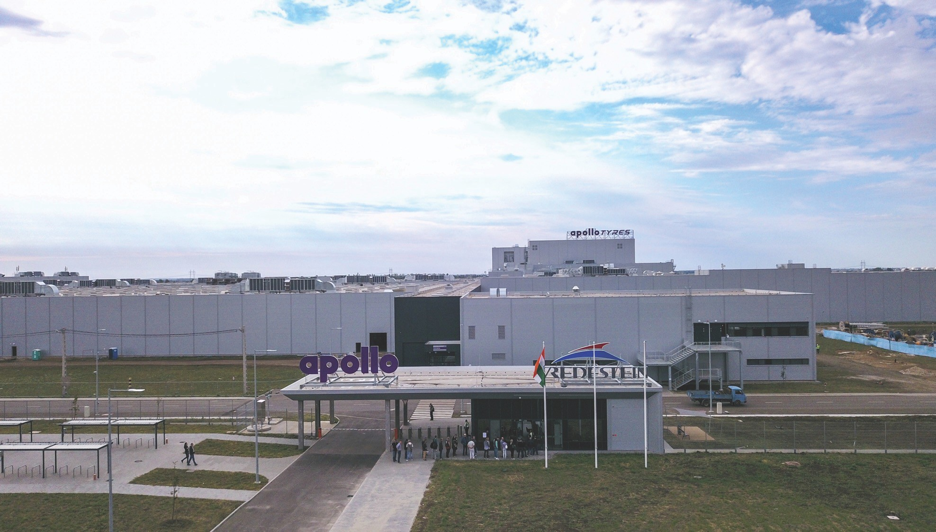
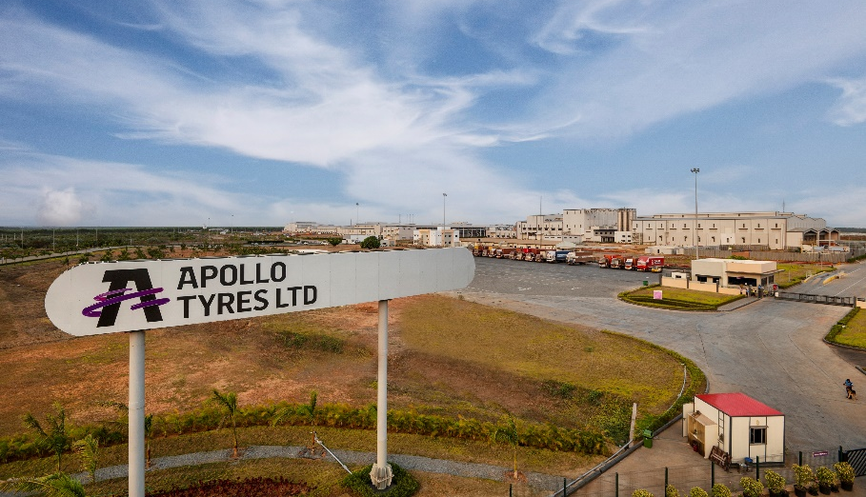
Manufacturing Facilities
7 Manufacturing facilities across Europe and India
Hungary Plant, Europe
Andhra Pradesh Plant, Asia

Slide 11
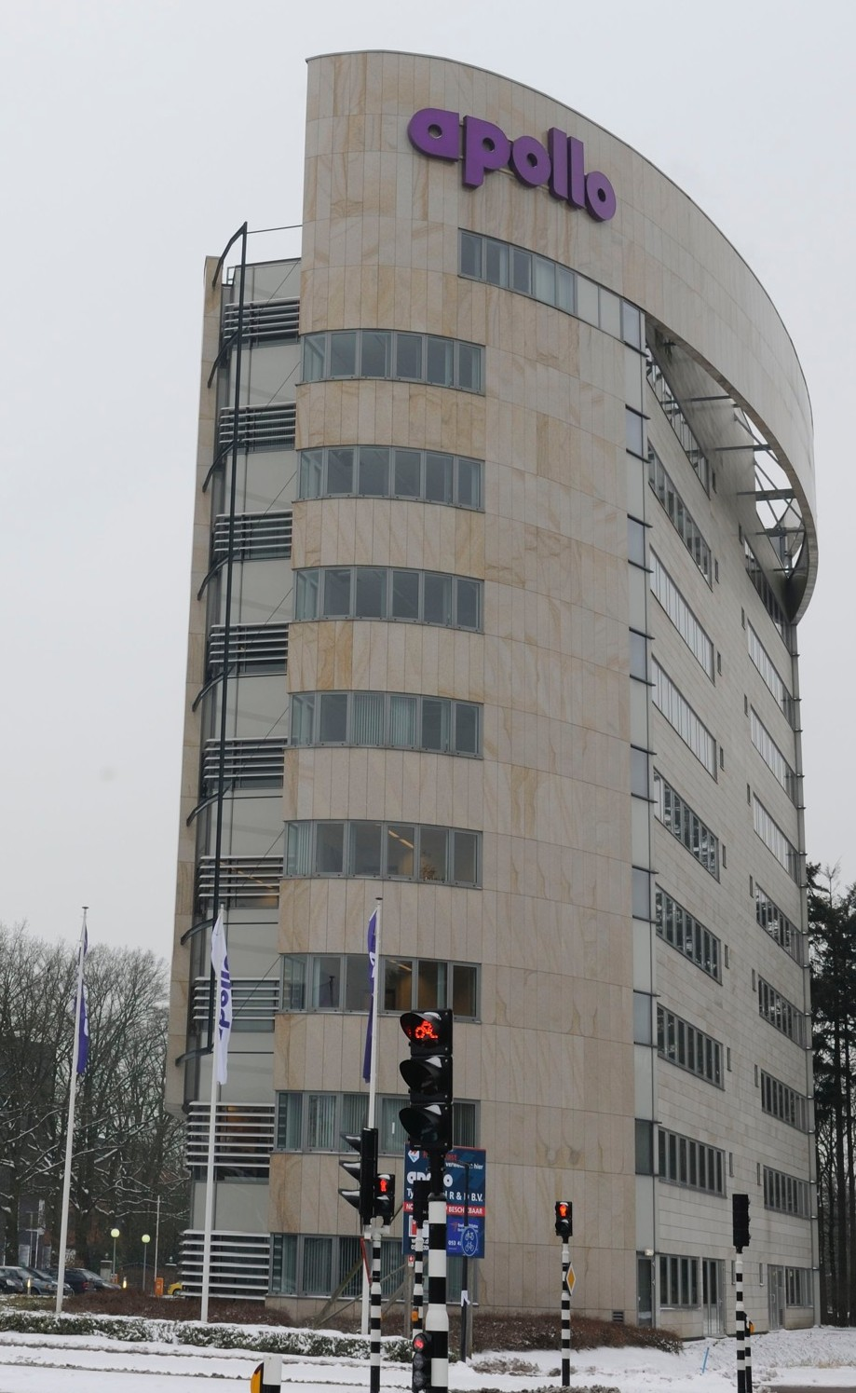
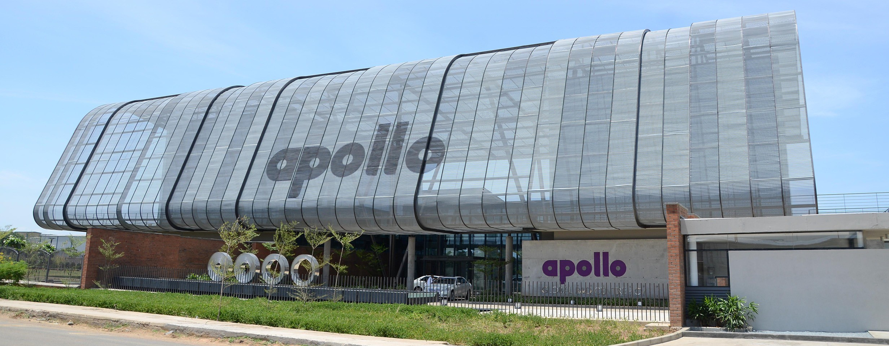
Global R&D
R&D India
Two Global R&D Centres based in India and the Netherlands
Over 400 R&D engineers and researchers
Cutting edge development across all product categories: CV, PV, OHT, SUV and TWT
R&D Europe
First manufacturer in India to be awarded ISO 17025 for track tests

Slide 12
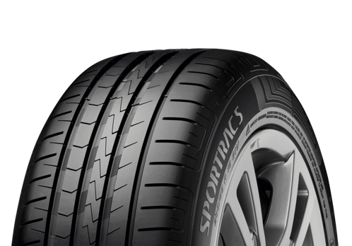
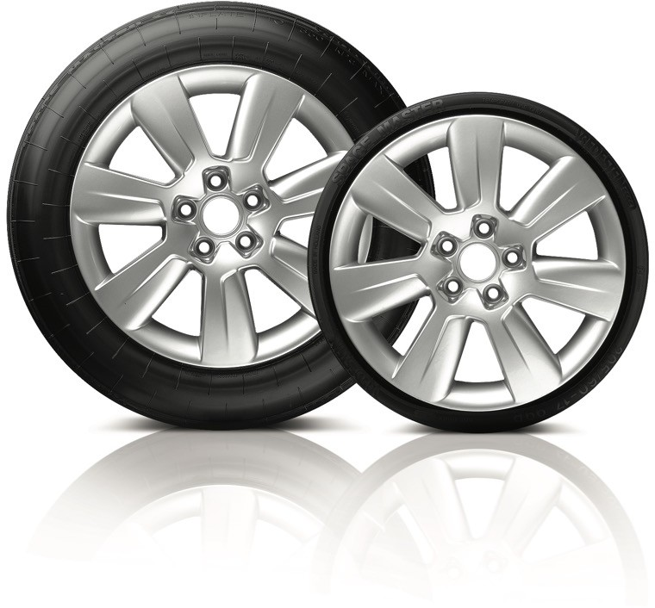
Global R&D Achievements
Over 200 patents filed on tyre technology across the global business with many of them filed in Europe, India and the USA.
Developed ultra-low rolling resistance technology (ULLR) for ‘A’ rating in Rolling Resistance label
Focus on creating tyres with sustainable, material in line with European green deal project
Developed Space Master – a collapsible spare tyre with high- end vehicles

Slide 13
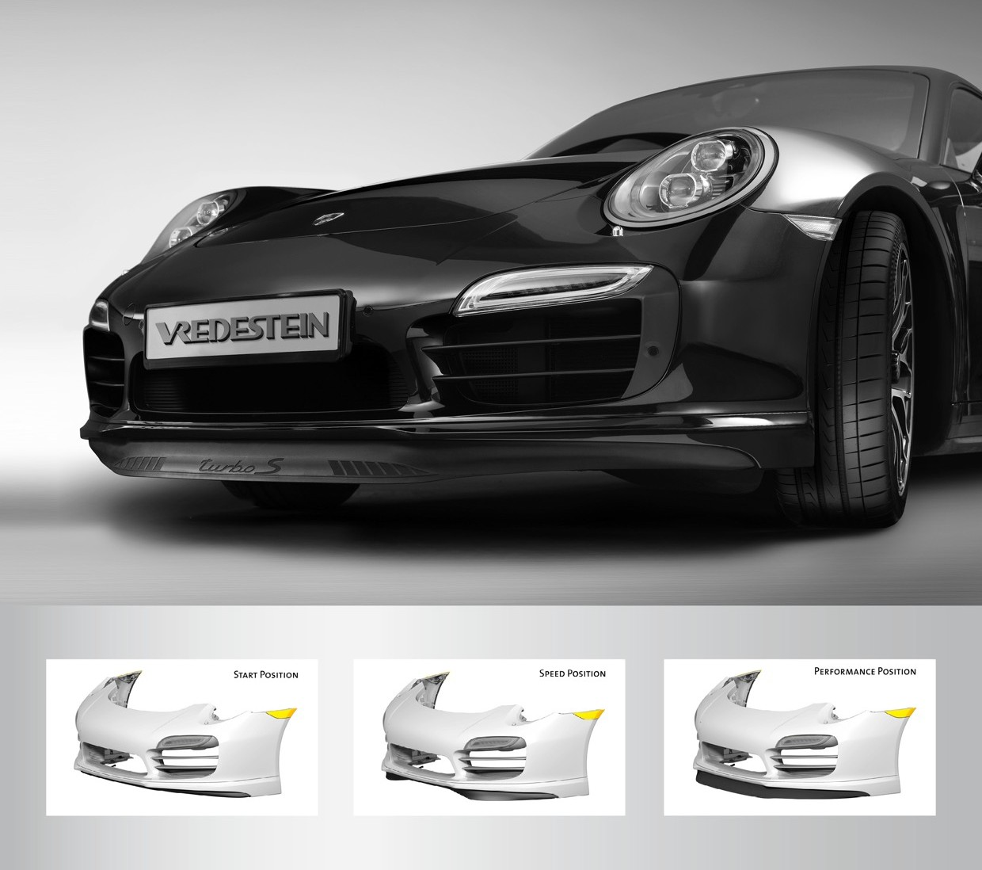
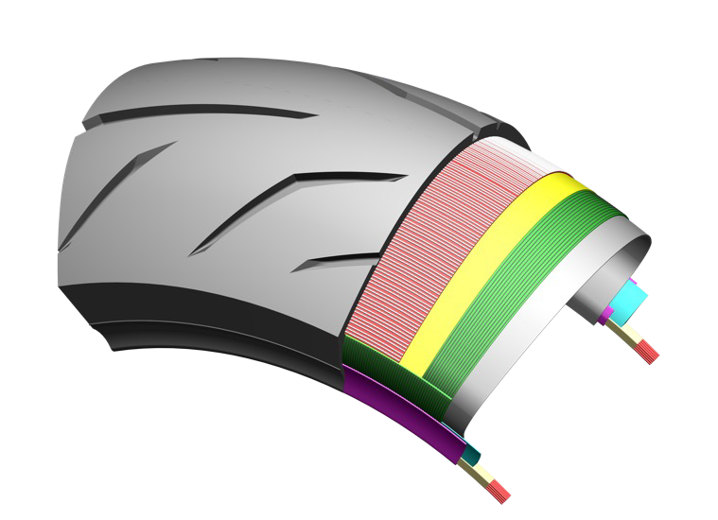
Global R&D Achievements
Launched a variable front spoiler made with a specially developed EPDM rubber for a high-end European sports car manufacturer
Developed fuel-efficient nRG series TBR tyres with no compromise on mileage or durability
Developed Zero Degree Steel Belted motor cycle technology for high performance radial tyres.

Slide 14
Two Global Product Brands

Slide 15
OE Partners

Slide 16
Sustainability
Achieving
across the entire value chain
6 Pillars FY26
1
Sustainability Governance
2
Climate Adaptation
3
Circular Economy
4
Value Chain
5
People
6
Community CSR
Sustainability is one of our key Pillars of vision FY26

Slide 17
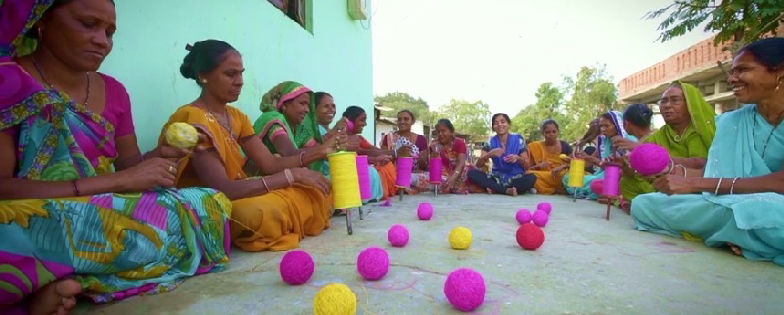
Our Approach
Our Vision
Initiatives are mapped to Sustainable Development Goals (SDGs) and particularly work on SDG17, Partnership for the Goals.
A Sustainability Steering Group reporting to the Board to drive the journey forward
Implemented ISO26000- Framework on Social Responsibility across the organisation
Commitment to be Carbon Neutral by 2050; Conducted Climate Risk Assessment as per Taskforce on Climate related Financial Disclosures Framework
Sourcing of Sustainable Natural rubber; Member of Global Platform for Sustainable Natural Rubber
Aspire to reach out to over 11 million beneficiaries through our Corporate Responsibility Programme across India and Europe by FY26

Slide 18
Our work spans across Europe and India
Biodiversity Conservation
India
Mangrove Conservation Project at Kerala
Afforestation project at Tamil Nadu
Europe
The Netherlands
Revitalisation of the City Stream
Project Enschede
Hungary
Conservation of Bukk National Park, Gyöngyöshalász,
Cleaning the meadows of
Mátra Mountain

Slide 19
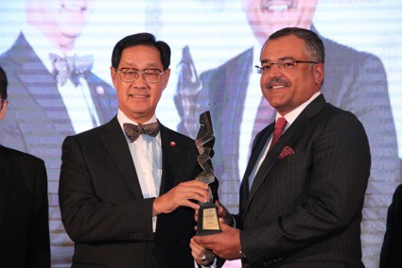
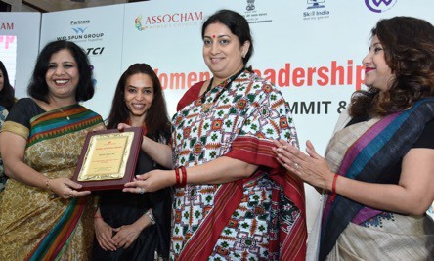
A Few Accolades
Recognition from Ministry of Health and Family Welfare for exceptional work in Health Care 2020
ICSI (The Institute of Company Secretaries of India) CSR Excellence Award 2019
Honoured with the 'ASSOCHAM Women Achievers Awards 2019 at 'Women Leadership & Empowerment Summit & Awards'
GCSRA award 2019 under 'Sustainable and Impactful CSR Project’ for its exemplary work in Gujarat for women empowerment through its Programme
ASIAN CSR Awards 2015 was given by Asian Forum on Corporate Social Responsibility, under the ‘Health Enhancement’ category
Asia Responsible Entrepreneurship Award 2012 was given by Enterprise Asia, under category for HIV-AIDS Awareness and Prevention Programme

Slide 20
Thank You

